Slide 1
Chapter 9(2): Virtual Memory
May, 2024

Slide 2
Chapter 9: Virtual Memory
Page Replacement
Thrashing
Other Considerations

Slide 3
Replacement algorithm
Objective
Reduce page-fault time（in ch9(1)）
Want lowest page-fault rate
Scope of replacement

Slide 4
Global vs. Local Replacement
Local replacement – each process selects from only its own set of allocated frames
More consistent per-process performance
But possibly under-utilized memory
Global replacement – process selects a replacement frame from the set of all frames; one process can take a frame from another
Then process execution time can vary greatly
But greater throughput so more common

Slide 5
Evaluate Algorithms
Evaluate algorithm by running it on a particular string of memory references (reference string) and computing the number of page faults on that string
String is just page numbers, not full addresses
Results depend on number of frames available
In all our examples, the reference string of referenced page numbers is
7,0,1,2,0, 3,0,4,2,3, 0,3,2,1,2, 0,1,7,0,1
3 physical frames

Slide 6
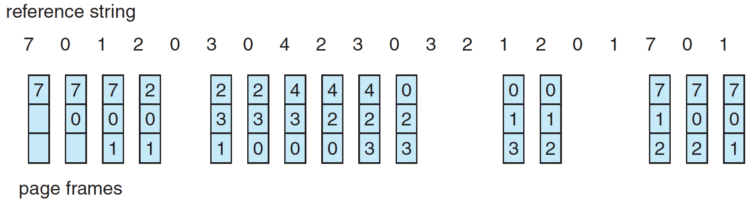
First-In-First-Out (FIFO) Algorithm
Reference string:
7,0,1,2,0, 3,0,4,2,3, 0,3,2,1,2, 0,1,7,0,1
3 frames (3 pages can be in memory at a time per process)
0
1
2
1
2
3
2
3
0
3
0
4
0
4
2
4
2
3
2
3
0
3
0
1
0
1
2
1
2
7
2
7
0
7
0
1
队首
Ordered:
Notes:
15 page faults

Slide 7
First-In-First-Out (FIFO) Algorithm
Adding more frames can cause more page faults!
Consider 1,2,3,4,1,2,5,1,2,3,4,5
4 vs 3 frames
Belady’s Anomaly
Notes:
9 vs 10 page faults
Reason: 5,1,2,3,4

Slide 8
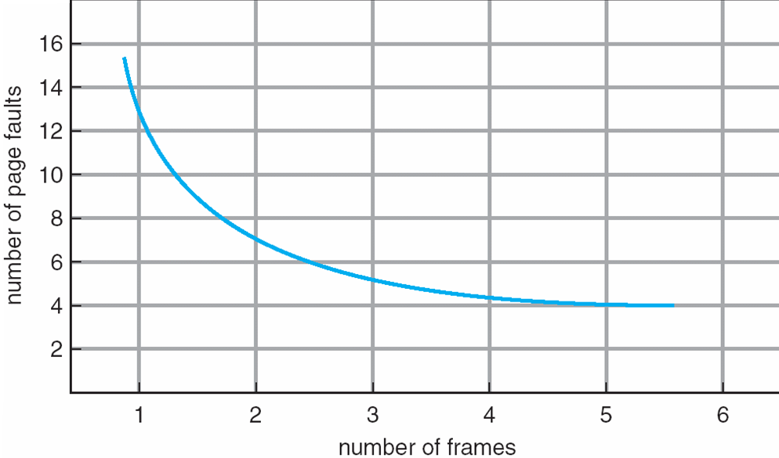
Graph of Page Faults Versus The Number of Frames

Slide 9
FIFO Illustrating Belady’s Anomaly

Slide 10
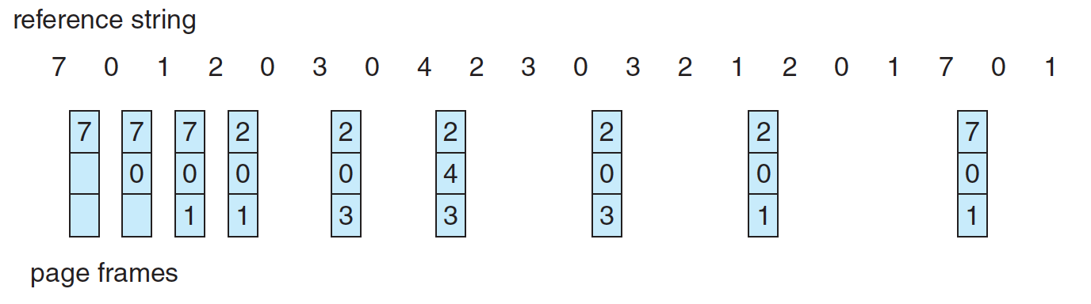
Optimal Algorithm
Replace page that will not be used for longest period of time
7,0,1,2,0, 3,0,4,2,3, 0,3,2,1,2, 0,1,7,0,1
Notes:
替换掉最长时间不会用到的（看未来）
9 page faults

Slide 11
Optimal Algorithm
Replace page that will not be used for longest period of time
How do you know this?
Can’t read the future
Used for measuring how well your algorithm performs

Slide 12
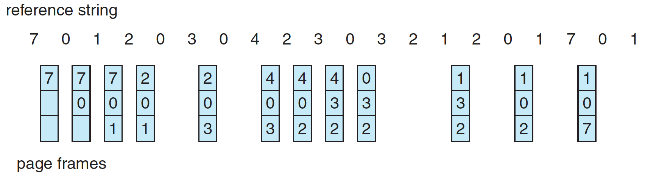
Least Recently Used (LRU) Algorithm
Use past knowledge rather than future
Replace page that has not been used in the most amount of time
Associate time of last use with each page
7,0,1,2,0, 3,0,4,2,3, 0,3,2,1,2, 0,1,7,0,1
0
1
2
1
2
0
2
0
3
2
3
0
3
0
4
0
4
2
4
2
3
2
3
0
2
0
3
0
3
2
3
2
1
3
1
2
1
2
0
2
0
1
0
1
7
1
7
0
7
0
1
队首
Ordered:
Notes:
用stack实现，新来的放栈底，栈顶的就是least recently used
12 page faults

Slide 13
Least Recently Used (LRU) Algorithm
Use past knowledge rather than future
Replace page that has not been used in the most amount of time
Associate time of last use with each page
Generally good algorithm and frequently used
But how to implement?
Counter
Stack

Slide 14
LRU Algorithm (Cont.)
Counter implementation
Every page entry has a counter; every time page is referenced through this entry, copy the clock into the counter
When a page needs to be changed, look at the counters to find smallest value
Search through table needed
Notes:
遍历

Slide 15
LRU Algorithm (Cont.)
Stack implementation
Keep a stack of page numbers in a double link form:
Page referenced:
move it to the top
No search for replacement, but each update more expensive
LRU and OPT are cases of stack algorithms that don’t have Belady’s Anomaly
Notes:
替换栈底；修改7个指针？

Slide 16
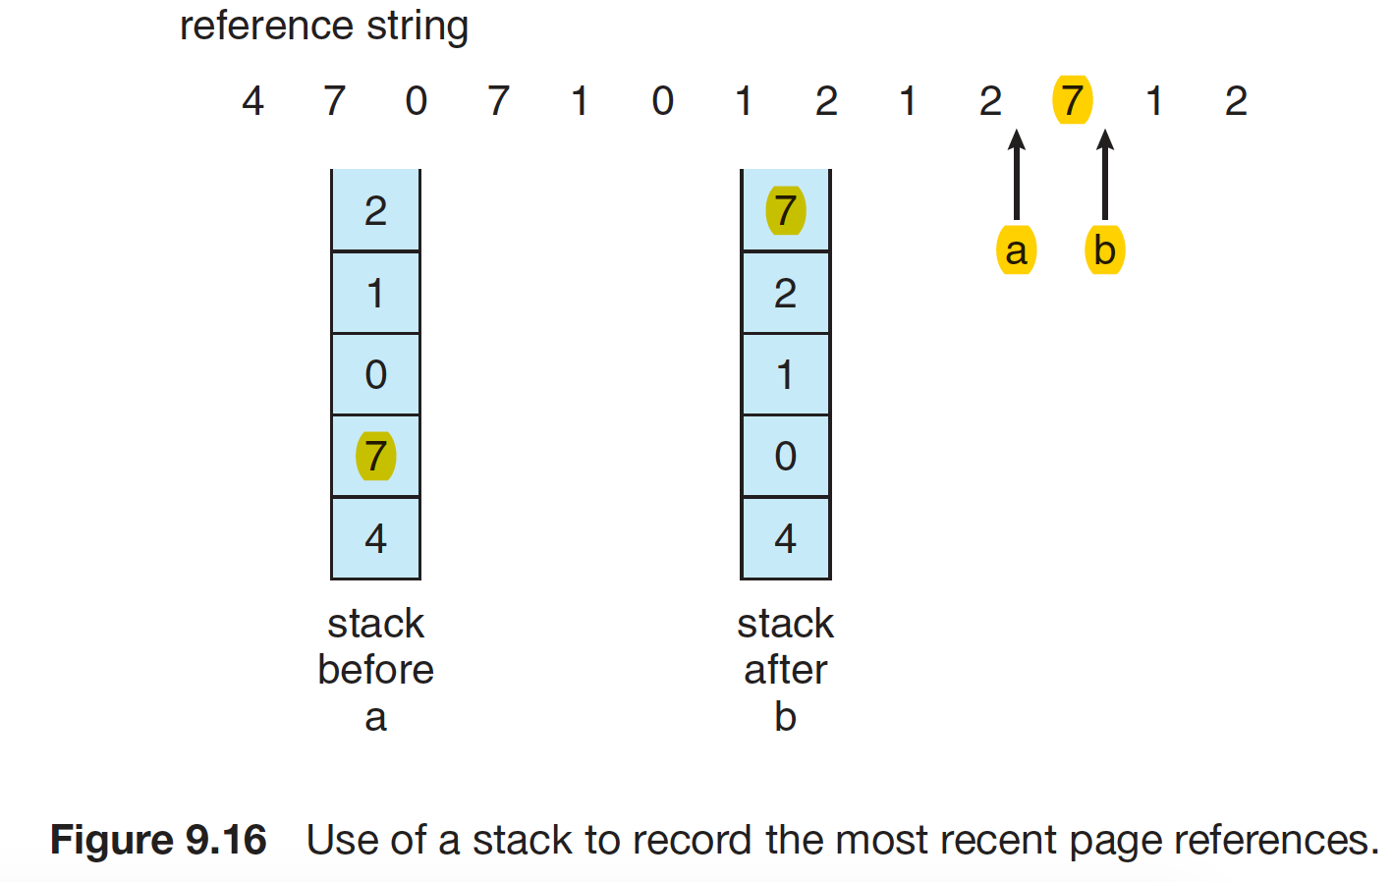
Use of A Stack to Record Most Recent Page References
Least recently used
Notes:
将最新引用的移到top，那就弹出栈底的

Slide 17
LRU Approximation Algorithms
LRU still slow
Reference bit
With each page associate a bit, initially = 0
When page is referenced bit set to 1
Replace page which reference bit = 0 (if one exists)
Page frame NO. |  |  |  | M | R | V
modify
valid
reference

Slide 18
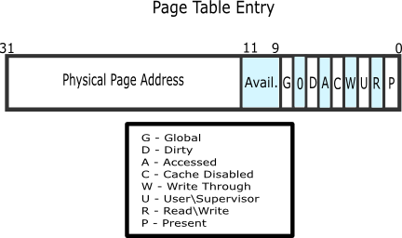
Example
Notes:
https://wiki.osdev.org/Paging

Slide 19
Second chance Algorithms
Second-chance algorithm (Clock algorithm)
Reference bit = 0 -> replace it
Reference bit = 1 then:
Set reference bit 0, leave page in memory
Go to next page, subject to same rules
What if 1,1,1,1,1……
那么转完一圈后全都变成0

Slide 20
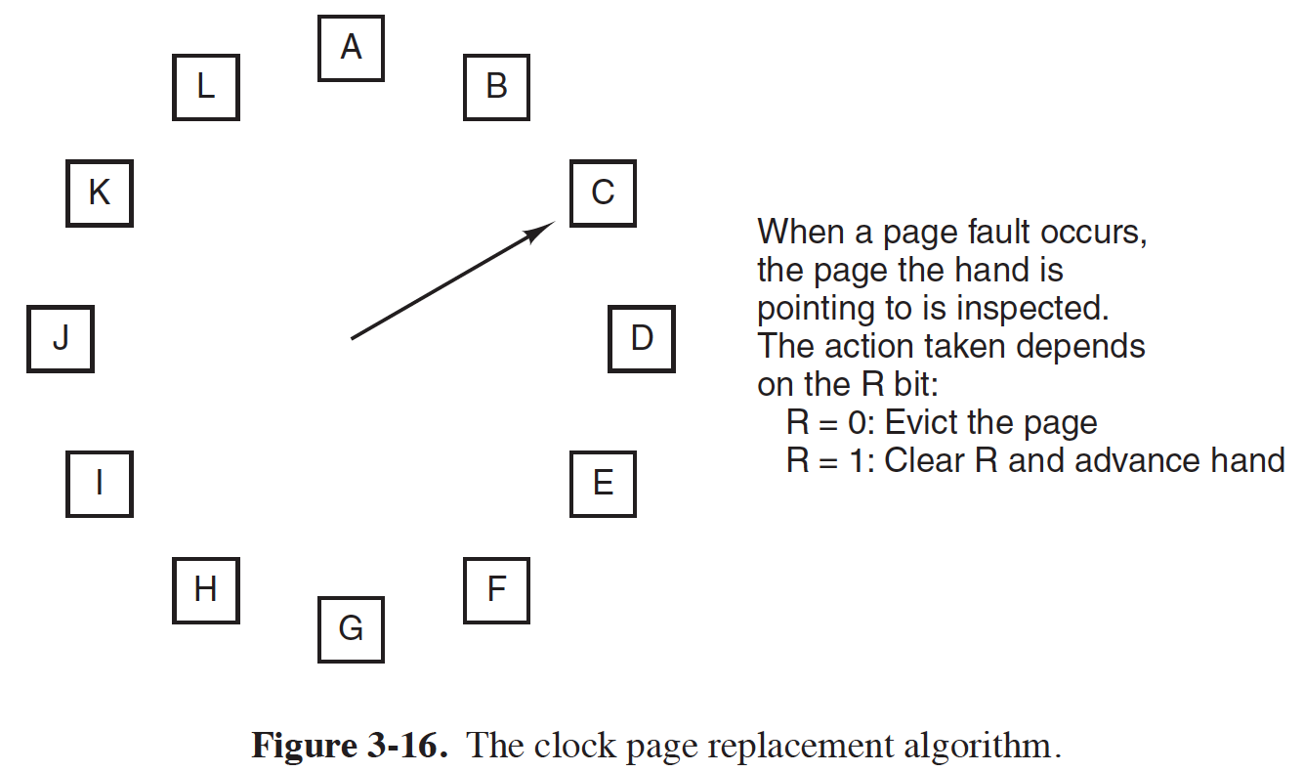
Clock algorithm
Notes:
Give an example?

Slide 21
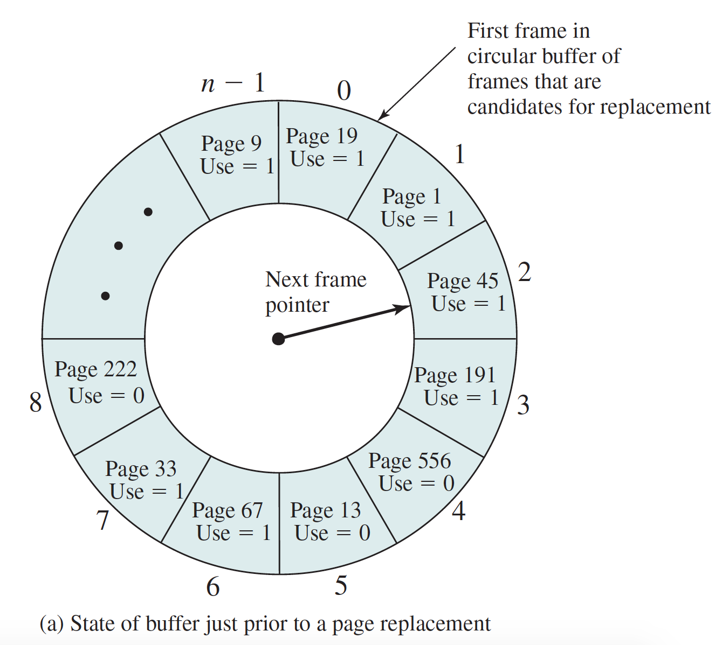
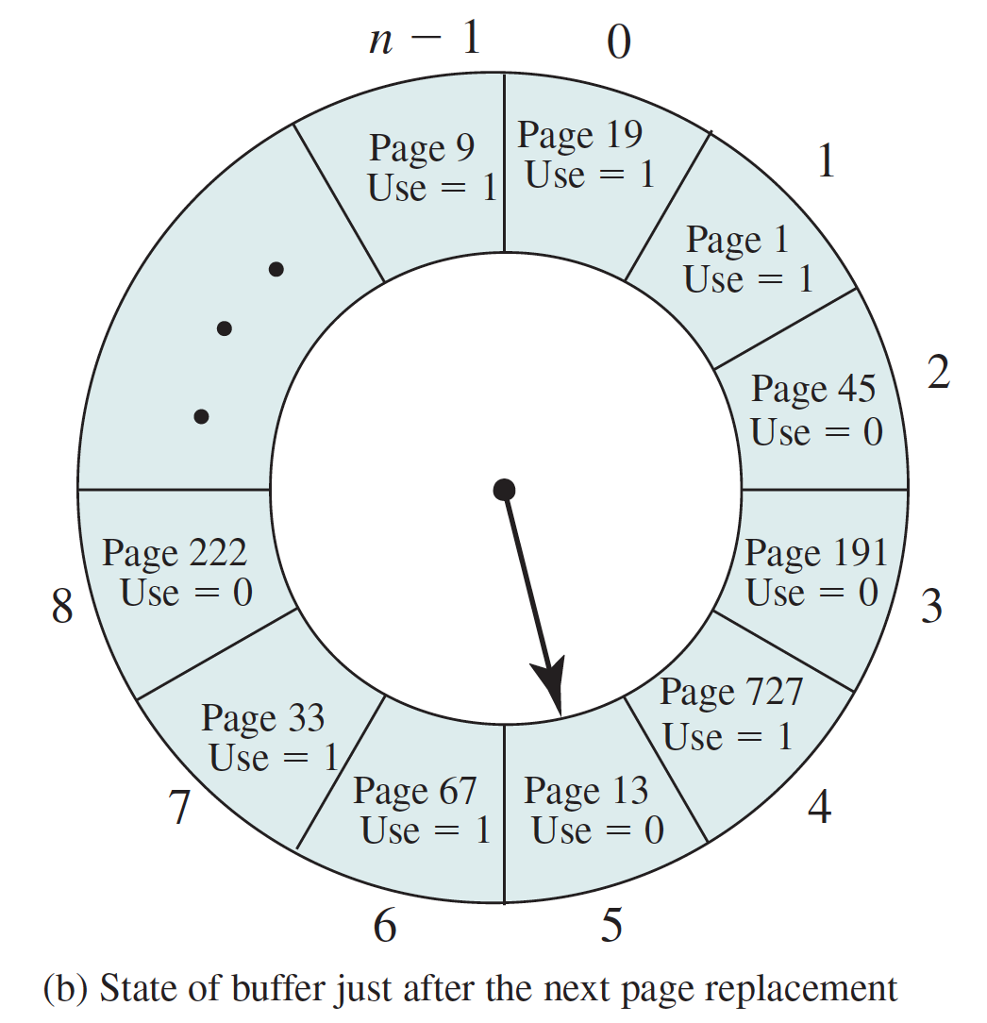
Clock Algorithm
Notes:
Next reference page 727, current pointer at frame 2. A circular buffer of n frames
当前的指针在2，转过的2和3都被改为0，给了它们二次机会

Slide 22
Enhanced Second-Chance Algorithm
Improve algorithm by using reference bit and modify bit (if available) in concert
Page frame NO. |  |  |  | M | R | V
modify
valid
修改位用来标志被加载进内存后是否被修改过。如果没有，那么swap的时候就不用写回直接销毁。能够减少磁盘IO次数，减少page fault time
reference
Notes:
刚才是只用reference的时钟算法
现在把modify bit也用上

Slide 23
Enhanced Second-Chance Algorithm
Take ordered pair (reference, modify)
(0, 0) neither recently used not modified
(0, 1) not recently used but modified
(1, 0) recently used but clean
(1, 1) recently used and modified
置换优先级由高到低
When page replacement called for, use the clock scheme but use the four classes replace page in lowest non-empty class
Might need to search circular queue several times
Notes:
Not used but modified?? 修改了一个文件但是很久没有打开过；OS修改或创建的文件（过程文件），用户没有引用过
(0, 0)：页面既没有被最近引用，也没有被修改。这种页面是最容易被换出的，因为它既不是最近需要的，也不需要写回磁盘。
(0, 1)：页面没有被最近引用，但已经被修改。这种页面需要被写回磁盘，因为它包含了对原始数据的更改。一旦写回，如果没有被再次引用，它可以被安全地换出。
(1, 0)：页面最近被引用，但没有被修改。这种页面是“干净”的，如果内存不足，它可以被换出，而不需要写回磁盘。由于它最近被访问过，根据局部性原理，它可能很快就会再次被需要。
(1, 1)：页面最近被引用并且已经被修改。这种页面是最不应该被换出的，因为它不仅包含了重要的更改，而且根据局部性原理，它很可能很快就会再次被访问。

Slide 24
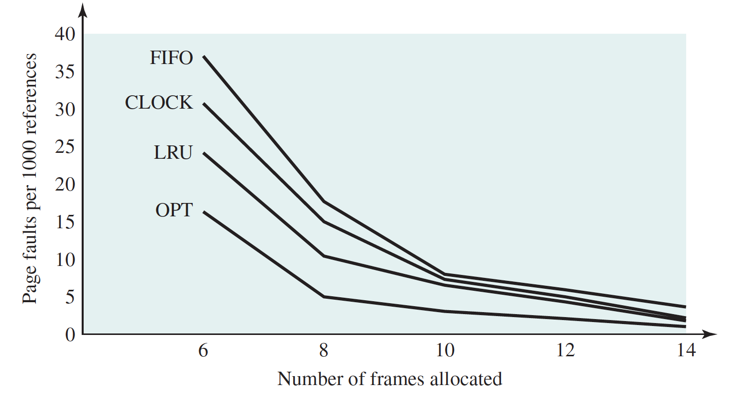
Comparison
Notes:
OPT最好，可惜无法实现

Slide 25
Thrashing
If a process does not have “enough” pages, the page-fault rate is very high
Page fault to get page
Replace existing frame
But quickly need replaced frame back
This leads to:
Low CPU utilization
Thrashing ≡ a process is busy swapping pages in and out（一个进程的调页时间大于它的执行时间）
Notes:
Give an example?
进程的每个frame都在执行，但是还需要更多frame，这就要换出频繁执行的页面，这样过一会又会发生页面错误。

Slide 26
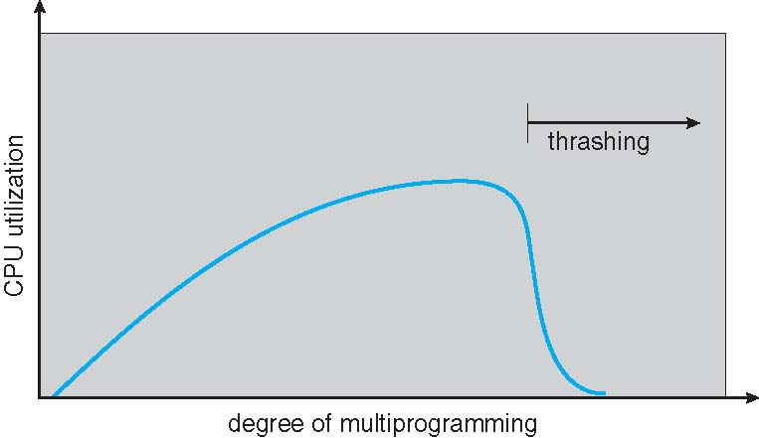
Thrashing (Cont.)
Notes:
如果CPU利用率太低，系统会引入新的进程。如果现在有一个进程需要更多的frame，它会开始发生缺页错误，并希望替换其他进程的frame，导致其它的进程也开始出现缺页错误。这些缺页错误在调页设备等待队列中排队，那么就绪队列的进程减少，CPU利用率减小，系统又引入其他进程，这些进程开始时肯定要调页，又排上队了。此时就出现了trashing（抖动）

Slide 27
Thrashing
Why does demand paging work? Locality model
Process migrates from one locality to another
就是给每个进程划定了一个局部性集合，不能超出这个集合置换别人的frame
Why does thrashing occur?
Σ size of locality > total memory size
所有进程的局部性集合的大小总和超过了总内存大小
Notes:
局部性原理是指程序倾向于频繁访问一小部分本地化的内存区域。这包括时间局部性（同一数据在短期内被多次访问）和空间局部性（程序倾向于顺序访问或访问接近的数据）。
需求调页只在程序实际需要访问一个页面时才将该页面加载到物理内存中。这意味着只有当前访问的页面和预计很快会被访问的页面会被加载。
局部性迁移：从一种局部性到另一种局部性
例如，一个程序可能最初在一个数组的开始处顺序访问元素（空间局部性），然后突然跳转到数组的末尾或其他位置进行访问。这时，它不再访问相邻的元素，而是访问之前访问过的元素（时间局部性）

Slide 28
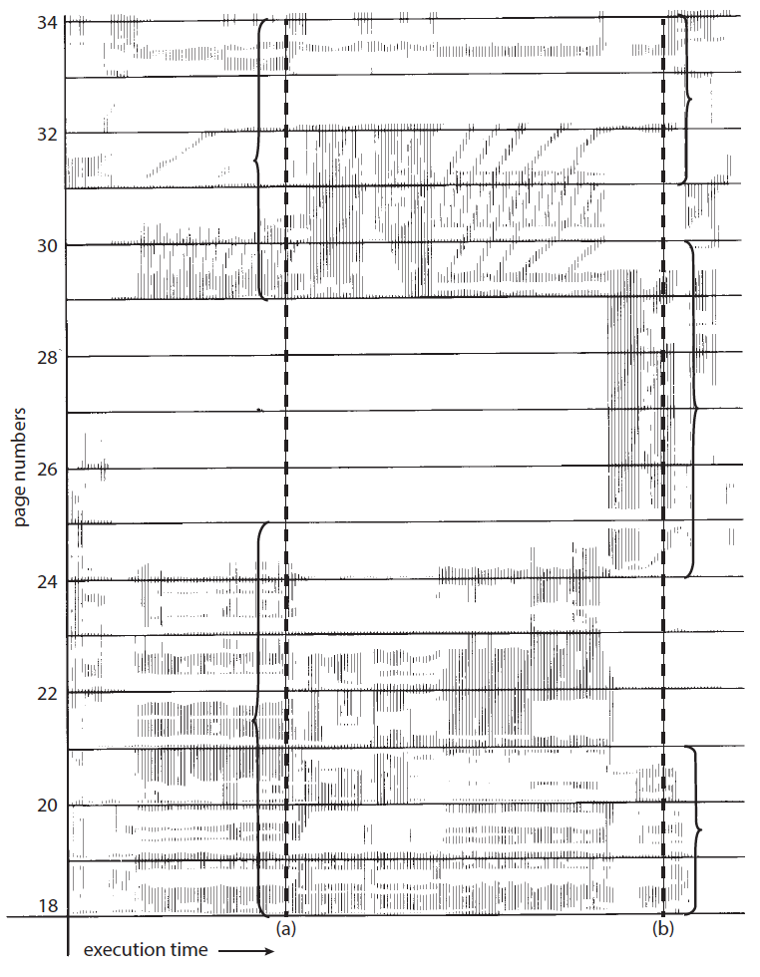
Locality In A Memory-Reference Pattern

Slide 29
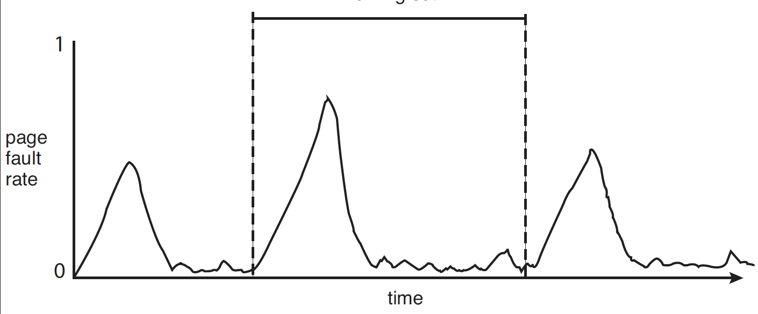
Locality and Page Fault Rates
locality
Notes:
前半段page fault峰值是因为，在为新的locality请求调页。
当这个新的locality的working set已经在内存中，page fault就会下降。

Slide 30
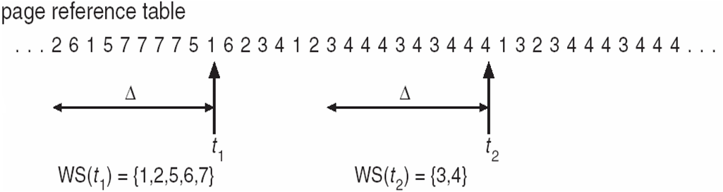
Working-Set Model
Working set: w(Δ,t)
Δ ≡ working-set window ≡ a fixed number of page references. Example: 10,000 instructions
t
WSS_{i} (working set size of Process P_{i}) = total number of pages referenced in the most recent Δ page references
Notes:
Working set是程序局部的近似
这里的page reference就是进程所调用的虚拟内存管理的page，就是page table的page，

Slide 31
Working-Set Model
WSS_{i} = total number of pages referenced in the most recent Δ page references（WS中的总页数）
if Δ too small will not encompass entire locality
if Δ too large will encompass several localities
if Δ = ∞ ⇒ will encompass entire program
Notes:
每个进程的WS中的页号可能有很多重复（毕竟虚拟内存），所以我们这里就用页数了

Slide 32
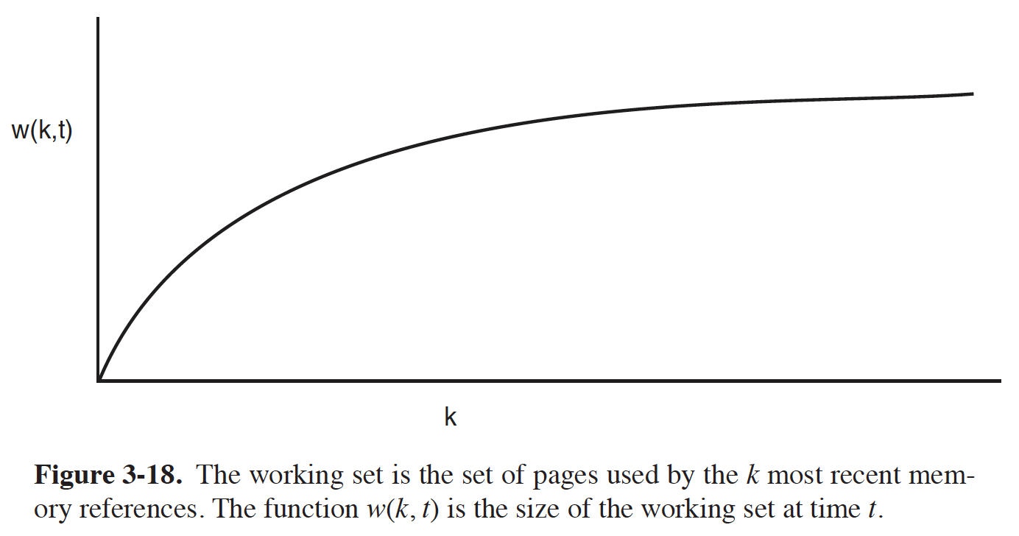
Working set size
Notes:
K变化，t不变

Slide 33
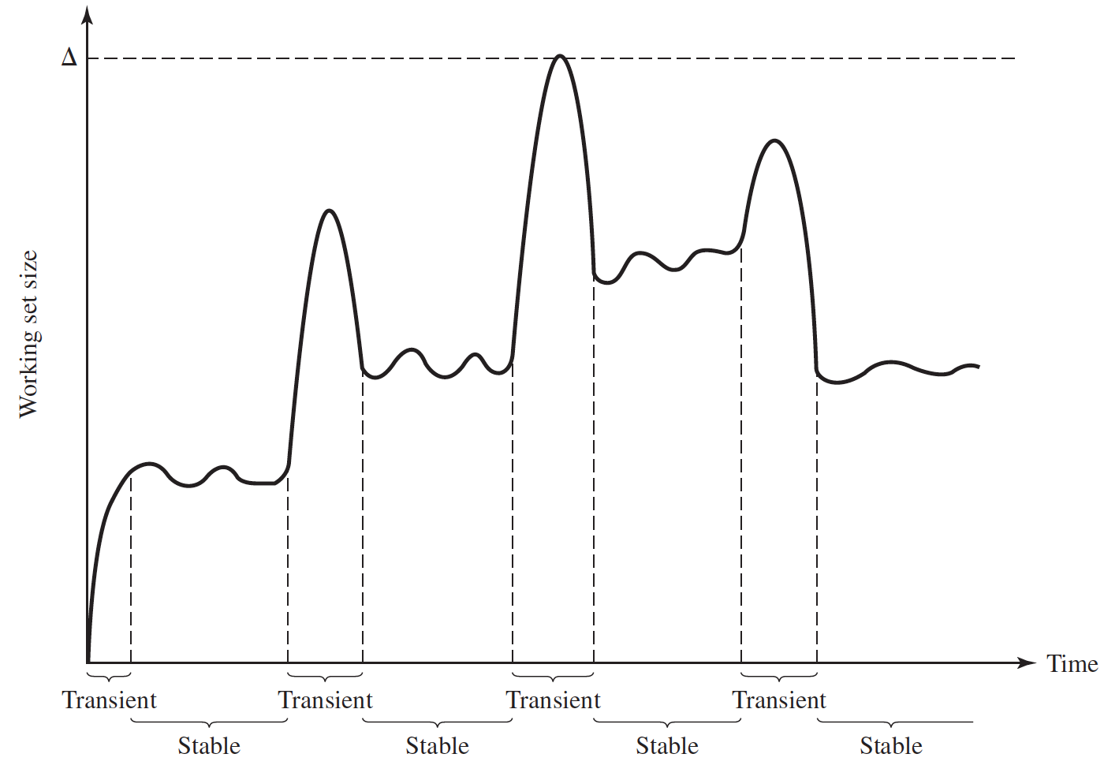
Working set size
Notes:
K不变=delta，t变

Slide 34
Working-Set Model
WSS_{i} = total number of pages referenced in the most recent Δ page references
D = Σ WSS_{i} ≡ total demand frames
Approximation of locality
if D > m ⇒ Thrashing (m: the number of frames)
Policy if D > m, then suspend or swap out one of the processes
Notes:
D是所有进程的working-set中页数的总和。
D大于总frame数，也就是trashing出现的原因

Slide 35
Other Considerations – Prepaging
Prepaging
To reduce the large number of page faults that occurs at process startup
Prepage all or some of the pages from the working set, before they are referenced
既然有了working set，那么就先把这些page先加载出来，防止一开始发生过多的page fault
Notes:
既然有了working set，那么就先把这些page先加载出来，防止一开始发生过多的page fault

Slide 36
Other Issues – Page Size
Page size selection must take into consideration:
Fragmentation (small)
Resolution and locality (small)
Page table size (big)
TLB size and effectiveness (big)
On average, growing over time
Notes:
Resolution: For example, consider a process 200 KB in size, of
which only half (100 KB) is actually used in an execution.
Number of page faults (big) ？？？？

Slide 37
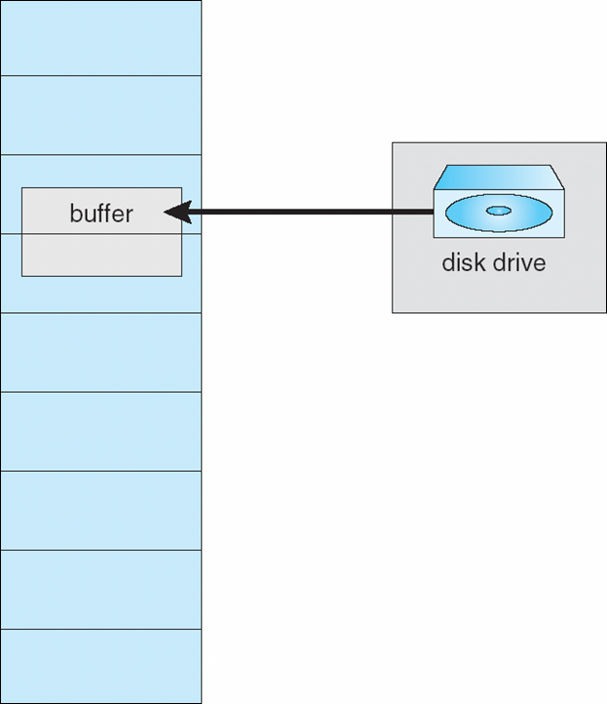
Other Issues – I/O interlock
I/O Interlock – Pages must sometimes be locked into memory
Consider I/O - Pages that are used for copying a file from a device must be locked from being selected for eviction by a page replacement algorithm
Pinning of pages（页面固定） to lock into memory
Notes:
Illustrate the background: double buffering/interlock

Slide 38
Other Issues – Program Structure
Program structure
int[128,128] data;
Each row is stored in one page
Program 1
for (j = 0; j < 128; j++) for (i = 0; i < 128; i++) data[i,j] = 0;
128 x 128 = 16,384 page faults
Program 2
for (i = 0; i < 128; i++) for (j = 0; j < 128; j++) data[i,j] = 0;
128 page faults
1 physical frame allocated
Notes:
1 frames allocated to the program
Also related to cache

Slide 39
End of Chapter 9(2)

Slide 40
Summary
Replacement
Memory
Cache
TLB entries
…...

Slide 41
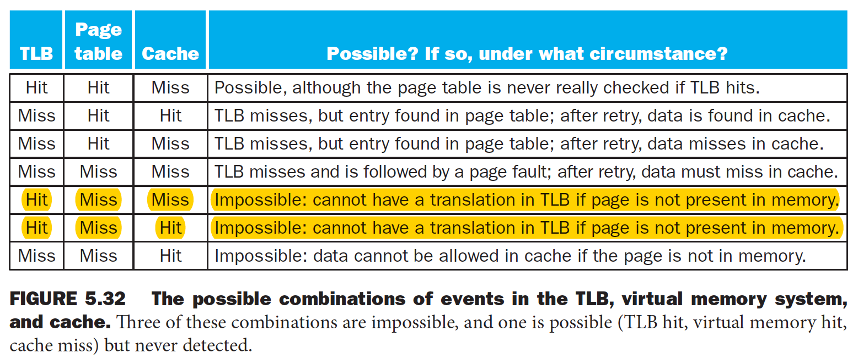
TLB, Page Table, Main Memory, Cache
Notes:
cat /proc/[pid]/oom_score

